Slide 1
Ethics in Information Technology, Fourth Edition
Computer and Internet Crime
Chapter 3
Notes:
‹#›

Slide 2
Objectives
As you read this chapter, consider the following questions:
What key trade-offs and ethical issues are associated with the safeguarding of data and information systems?
Why has there been a dramatic increase in the number of computer-related security incidents in recent years?
What are the most common types of computer security attacks?
Ethics in Information Technology, Fourth Edition
Notes:
‹#›

Slide 3
Objectives (cont’d.)
Who are the primary perpetrators of computer crime, and what are their objectives?
What are the key elements of a multilayer process for managing security vulnerabilities based on the concept of reasonable assurance?
What actions must be taken in response to a security incident?
What is computer forensics, and what role does it play in responding to a computer incident?
Ethics in Information Technology, Fourth Edition
Notes:
‹#›

Slide 4
IT Security Incidents: A Major Concern
Security of information technology is of utmost importance
Safeguard:
Confidential business data
Private customer and employee data
Protect against malicious acts of theft or disruption
Balance against other business needs and issues
Number of IT-related security incidents is increasing around the world
Ethics in Information Technology, Fourth Edition
Notes:
‹#›

Slide 5
Why Computer Incidents Are So Prevalent
Increasing complexity increases vulnerability
Computing environment is enormously complex
Continues to increase in complexity
Number of entry points expands continuously
Cloud computing and virtualization software
Higher computer user expectations
Computer help desks under intense pressure
Forget to verify users’ IDs or check authorizations
Computer users share login IDs and passwords
Ethics in Information Technology, Fourth Edition
Notes:
‹#›

Slide 6
Why Computer Incidents Are So Prevalent (cont’d.)
Expanding/changing systems equal new risks
Network era
Personal computers connect to networks with millions of other computers
All capable of sharing information
Information technology
Is everywhere
Necessary tool for organizations to achieve goals
Increasingly difficult to match pace of technological change for risk assessment
Ethics in Information Technology, Fourth Edition
Notes:
‹#›

Slide 7
Why Computer Incidents Are So Prevalent (cont’d.)
Increased reliance on commercial software with known vulnerabilities
Exploit
Attack on information system
Takes advantage of system vulnerability
Due to poor system design or implementation
Patch
“Fix” to eliminate the problem
Users are responsible for obtaining and installing
Delays expose users to security breaches
Ethics in Information Technology, Fourth Edition
Notes:
‹#›

Slide 8
Why Computer Incidents Are So Prevalent (cont’d.)
Zero-day attack
Before a vulnerability is discovered or fixed
U.S. companies rely on commercial software with known vulnerabilities
Ethics in Information Technology, Fourth Edition
Notes:
‹#›

Slide 9
Types of Exploits
Computers as well as smartphones can be target
Types of attacks
Virus
Worm
Trojan horse
Distributed denial of service
Rootkit
Spam
Phishing (spear-phishing, smishing, and vishing)
Ethics in Information Technology, Fourth Edition
Notes:
‹#›

Slide 10
Viruses
Pieces of programming code
Usually disguised as something else
Cause unexpected and undesirable behavior
Often attached to files
Deliver a “payload”
Spread by actions of the “infected” computer user
Infected e-mail document attachments
Downloads of infected programs
Visits to infected Web sites
Ethics in Information Technology, Fourth Edition
Notes:
‹#›

Slide 11
Worms
Harmful programs
Reside in active memory of a computer
Duplicate themselves
Can propagate without human intervention
Negative impact of worm attack
Lost data and programs
Lost productivity
Additional effort for IT workers
Ethics in Information Technology, Fourth Edition
Notes:
‹#›

Slide 12
Trojan Horses
Malicious code hidden inside seemingly harmless programs
Users are tricked into installing them
Delivered via email attachment, downloaded from a Web site, or contracted via a removable media device
Some pirated copies of this software contain a Trojan horse
Logic bomb
Executes when triggered by certain event
Ethics in Information Technology, Fourth Edition
Notes:
‹#›

Slide 13
Distributed Denial-of-Service (DDoS) Attacks
Malicious hacker takes over computers on the Internet and causes them to flood a target site with demands for data and other small tasks
The computers that are taken over are called zombies
Botnet is a very large group of such computers
Does not involve a break-in at the target computer
Target machine is busy responding to a stream of automated requests
Legitimate users cannot access target machine
Ethics in Information Technology, Fourth Edition
Notes:
‹#›

Slide 14
Rootkits
Set of programs that enables its user to gain administrator-level access to a computer without the end user’s consent or knowledge
Attacker can gain full control of the system and even obscure the presence of the rootkit
Fundamental problem in detecting a rootkit is that the operating system currently running cannot be trusted to provide valid test results
Ethics in Information Technology, Fourth Edition

Slide 15
Rootkits
symptoms of rootkit infections:
• The computer locks up or fails to respond to input from the keyboard or mouse.
• The screen saver changes without any action on the part of the user.
• The taskbar disappears.
• Network activities function extremely slowly.
Ethics in Information Technology, Fourth Edition

Slide 16
Spam
Abuse of email systems to send unsolicited email to large numbers of people
Low-cost commercial advertising for questionable products
Method of marketing also used by many legitimate organizations
Controlling the Assault of Non-Solicited Pornography and Marketing (CAN-SPAM) Act
Legal to spam if basic requirements are met
Ethics in Information Technology, Fourth Edition

Slide 17
Spam (cont’d.)
Completely Automated Public Turing Test to Tell Computers and Humans Apart (CAPTCHA)
Software generates tests that humans can pass but computer programs cannot
Ethics in Information Technology, Fourth Edition

Slide 18
Spam (cont’d.)
For nearly five years, Edward Davidson ran a spamming, he managed a large network of computers that sent hundreds of thousands of spam e-mails, promoted the sale of watches, perfume, and other items for nearly two dozen companies. Davidson and his subcontractors sent e-mail messages with header information that concealed the actual sender from the recipient of the e-mail—a violation of the federal CAN-SPAM Act. In April 2008, Edward Davidson was sentenced to serve 21 months in federal prison for violation of the CAN-SPAM Act. He was also ordered to pay $714,139 in restitution to the IRS for taxes on income from the operation that he failed to report.
Ethics in Information Technology, Fourth Edition

Slide 19
Phishing
Act of using email fraudulently to try to get the recipient to reveal personal data
Legitimate-looking emails lead users to counterfeit Web sites
Spear-phishing
Fraudulent emails to an organization’s employees
Smishing
Phishing via text messages
Vishing
Phishing via voice mail messages
Ethics in Information Technology, Fourth Edition

Slide 20
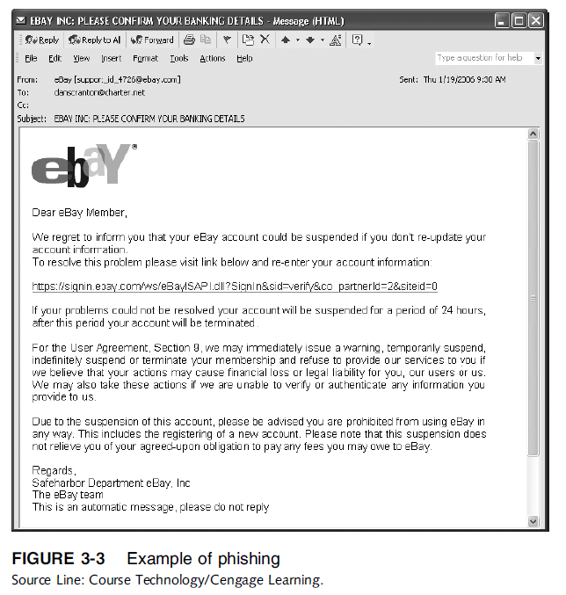
Ethics in Information Technology, Fourth Edition

Slide 21
Types of Perpetrators
Perpetrators include:
Thrill seekers wanting a challenge
Common criminals looking for financial gain
Industrial spies trying to gain an advantage
Terrorists seeking to cause destruction
Different objectives and access to varying resources
Willing to take different levels of risk to accomplish an objective
Ethics in Information Technology, Fourth Edition
Notes:
‹#›

Slide 22
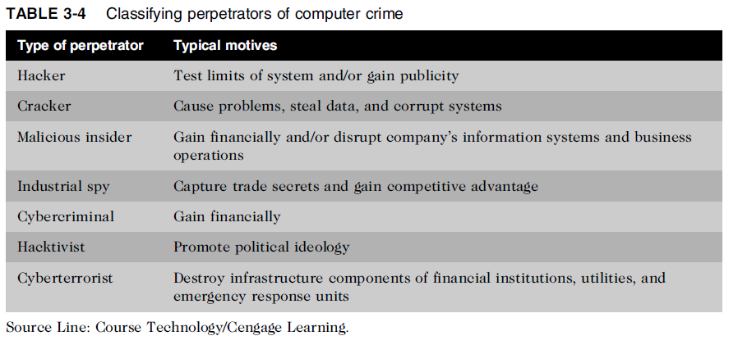
Types of Perpetrators (cont’d.)
Ethics in Information Technology, Fourth Edition
Notes:
‹#›

Slide 23
Hackers and Crackers
Hackers
Test limitations of systems out of intellectual curiosity
Some smart and talented
Others inept; termed “lamers” or “script kiddies”
Crackers
Cracking is a form of hacking
Clearly criminal activity
Ethics in Information Technology, Fourth Edition
Notes:
‹#›

Slide 24
Malicious Insiders
Major security concern for companies
Fraud within an organization is usually due to weaknesses in internal control procedures
Collusion
Cooperation between an employee and an outsider
Insiders are not necessarily employees
Can also be consultants and contractors
Extremely difficult to detect or stop
Authorized to access the very systems they abuse
Negligent insiders have potential to cause damage
Ethics in Information Technology, Fourth Edition
Notes:
‹#›

Slide 25
Industrial Spies
Use illegal means to obtain trade secrets from competitors
Trade secrets are protected by the Economic Espionage Act of 1996
Competitive intelligence
Uses legal techniques
Gathers information available to the public
Industrial espionage
Uses illegal means
Obtains information not available to the public
Ethics in Information Technology, Fourth Edition
Notes:
‹#›

Slide 26
Cybercriminals
Hack into corporate computers to steal
Engage in all forms of computer fraud
Chargebacks are disputed transactions
Loss of customer trust has more impact than fraud
Ethics in Information Technology, Fourth Edition
Notes:
‹#›

Slide 27
Hacktivists and Cyberterrorists
Hacktivism
Hacking to achieve a political or social goal
Cyberterrorist
Attacks computers or networks in an attempt to intimidate or coerce a government in order to advance certain political or social objectives
Seeks to cause harm rather than gather information
Uses techniques that destroy or disrupt services
Ethics in Information Technology, Fourth Edition

Slide 28
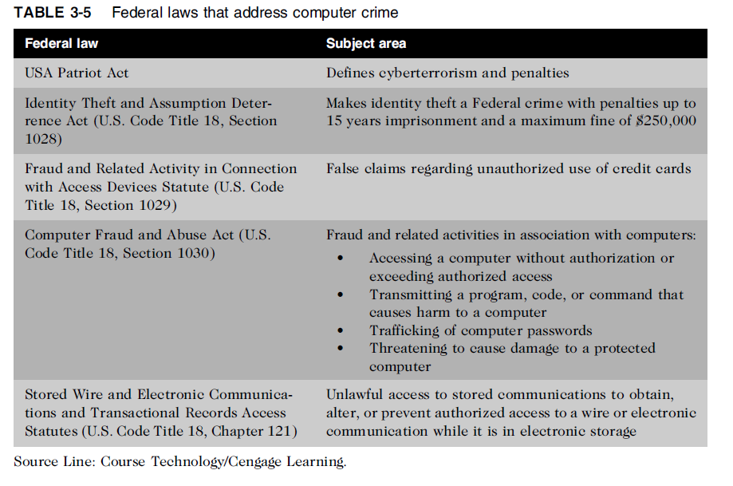
Federal Laws for Prosecuting Computer Attacks
Ethics in Information Technology, Fourth Edition

Slide 29
Summary
Ethical decisions in determining which information systems and data most need protection
Most common computer exploits
Viruses
Worms
Trojan horses
Distributed denial-of-service attacks
Rootkits
Spam
Phishing, spear-fishing, smishing, vishing
Ethics in Information Technology, Fourth Edition
Notes:
‹#›

Slide 30
Summary (cont’d.)
Perpetrators include:
Hackers
Crackers
Malicious insider
Industrial spies
Cybercriminals
Hacktivist
Cyberterrorists
Ethics in Information Technology, Fourth Edition
Notes:
‹#›

Slide 31
Summary (cont’d.)
Must implement multilayer process for managing security vulnerabilities, including:
Assessment of threats
Identifying actions to address vulnerabilities
User education
IT must lead the effort to implement:
Security policies and procedures
Hardware and software to prevent security breaches
Computer forensics is key to fighting computer crime in a court of law
Ethics in Information Technology, Fourth Edition
Notes:
‹#›

